Slide 1



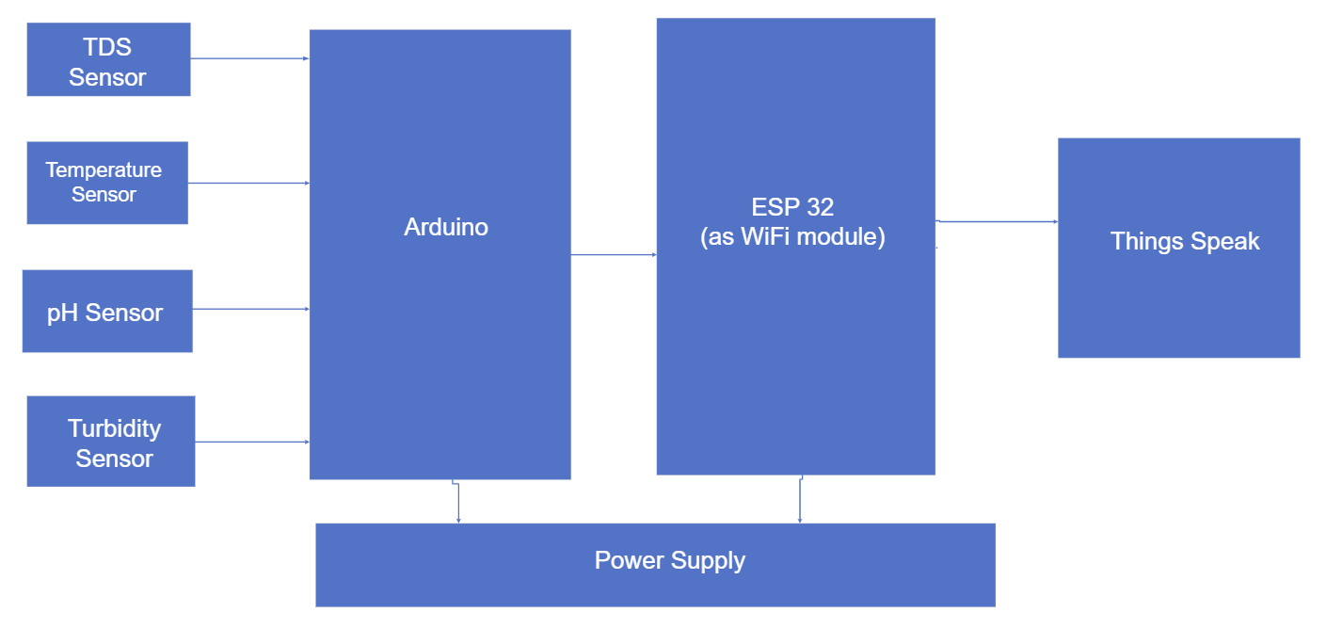
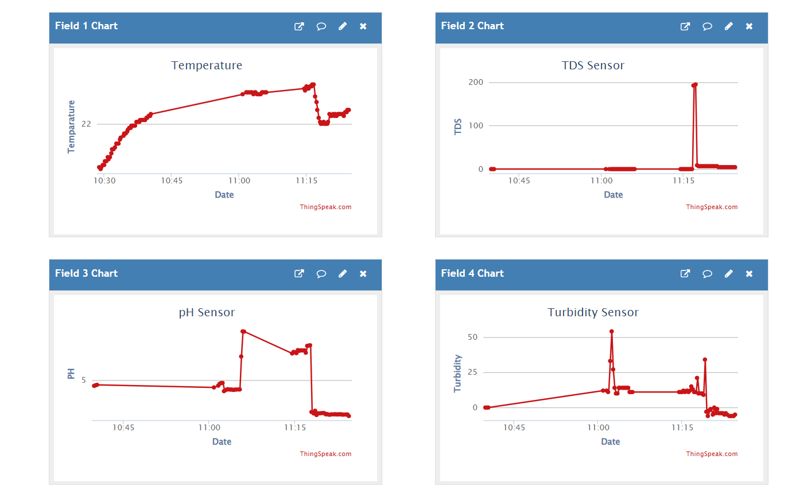
WATER QUALITY MONITORING SYSTEM
Faculty Advisor: Dr. Erick C. Jones, Jr.
Sisira Reddy Palli | Venkata Sri Deepthi SriKotaPeetambaram | Sambhav Jain
Methodology and System Overview
Water quality monitoring is vital for safeguarding both environmental health and public well-being. It helps us track and understand the chemical, physical, and biological aspects of water bodies, identifying contaminants and assessing ecosystem health. Through systematic monitoring efforts, we can address emerging threats and ensure the sustainability of our water resources.
Our research focuses on developing an innovative approach to water quality monitoring by integrating turbidity, Total Dissolved Solids (TDS), pH, and temperature sensors into a comprehensive system. This integrated setup allows us to gather simultaneous real-time data on multiple parameters, enhancing our understanding of aquatic ecosystems. Additionally, we employ machine learning techniques to predict water quality based on sensor data, enabling proactive interventions to protect human health and ecosystem integrity.
Preliminary results demonstrate the effectiveness of our integrated sensor system in providing accurate measurements of water parameters. By employing machine learning techniques, we can forecast water quality, offering proactive measures to address pollution events and environmental changes.
Our integrated sensor system operates by leveraging Arduino for data collection from pH, turbidity, temperature, and TDS sensors, with an ESP32 serving as the Wi-Fi module for data transmission. Each sensor provides real-time measurements of its respective parameter. The Arduino processes these readings and sends them wirelessly to ThingSpeak, an IoT platform, utilizing the ESP32's Wi-Fi capabilities. ThingSpeak then organizes the incoming data and generates comprehensive graphs to visualize trends and fluctuations over time for each monitored parameter. This setup enables simultaneous monitoring of pH, turbidity, TDS, and temperature, offering a holistic view of water quality. The system's integration ensures seamless data collection and analysis, facilitating efficient management and decision-making in various applications such as environmental monitoring or water treatment processes.
Introduction
Data Analysis
Evaluation of accuracy highlights variations in measurement precision across parameters and water types. Temperature readings demonstrate high accuracy across all samples, while TDS measurements exhibit varying degrees of precision, with the highest accuracy observed in tap water. pH measurements generally display high accuracy, except for lemon water, suggesting potential challenges in accurately assessing pH in acidic solutions. These insights emphasize the importance of using reliable sensors for precise water quality monitoring and decision-making in various contexts, from household use to industrial applications.
Main Findings
Here are the readings:
With sensors | Temperature | TDS | pH
Bottled water | 25.12 | 125 | 7.14
Tap water | 24.12 | 147 | 6.67
Lemon water | 24.31 | 441 | 2.61
Soap | 24.31 | 476 | 8.28
With measurement devices
Bottled water | 25.2 | 158 | 7.09
Tap water | 24.12 | 229 | 6.62
Lemon water | 24.1 | 706 | 2.8
Soap | 23.6 | 676 | 8.17
Graphical Representations on Thingspeak
Block Diagram and Connections
References
World Health Organization. (2023). Drinking-water. Fact sheet. https://www.who.int/news-room/fact-sheets/detail/drinking-water
IISD. (2019). UNEP Highlights Funding Needs for Water Quality Monitoring. SDG Knowledge Hub. https://sdg.iisd.org/news/unep-highlights-funding-needs-for-water-quality-monitoring/
Environmental Protection Agency. (n.d.). Clean Water Act (CWA) compliance monitoring. Retrieved from https://www.epa.gov/compliance/clean-water-act-cwa-compliance-monitoring

